Slide 1
Programmatic Navigation

Slide 2
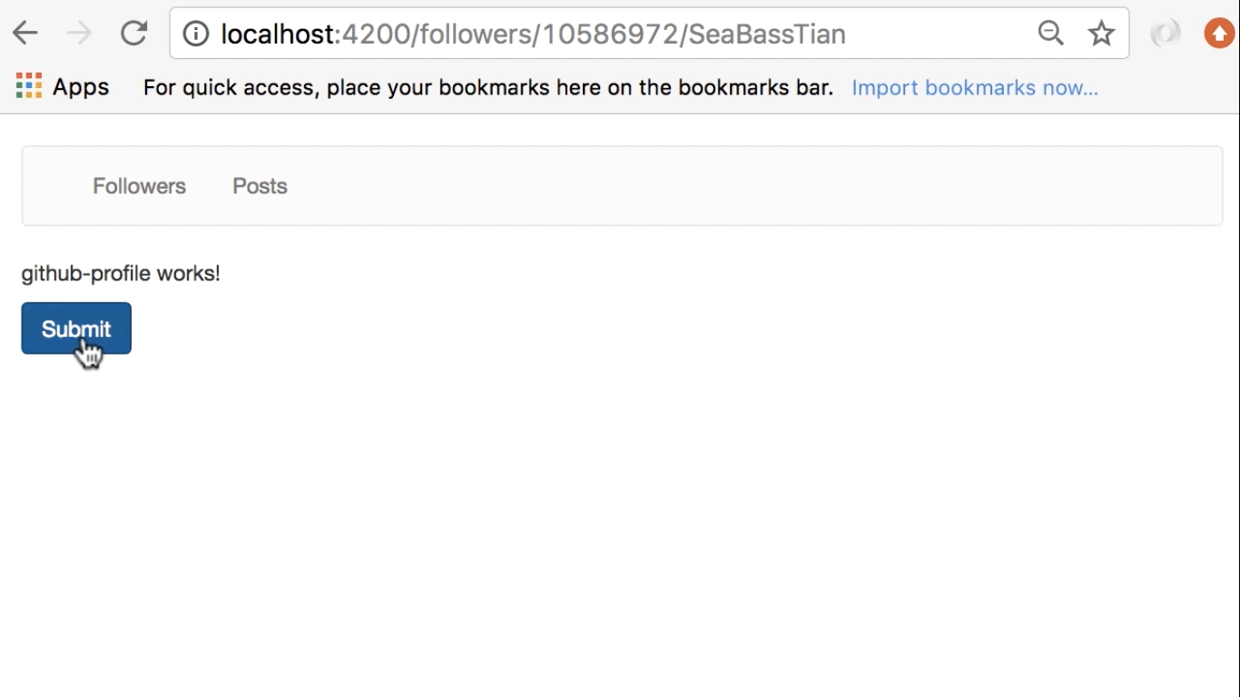
When we click the Submit button
We are going to call the server to update the user’s profile and then
Navigate back to list of followers page

Slide 3
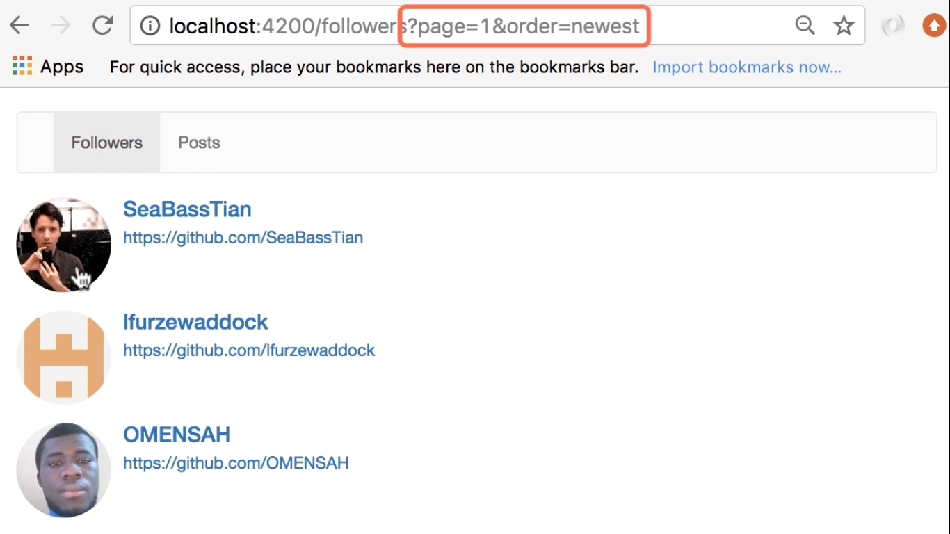

Slide 4
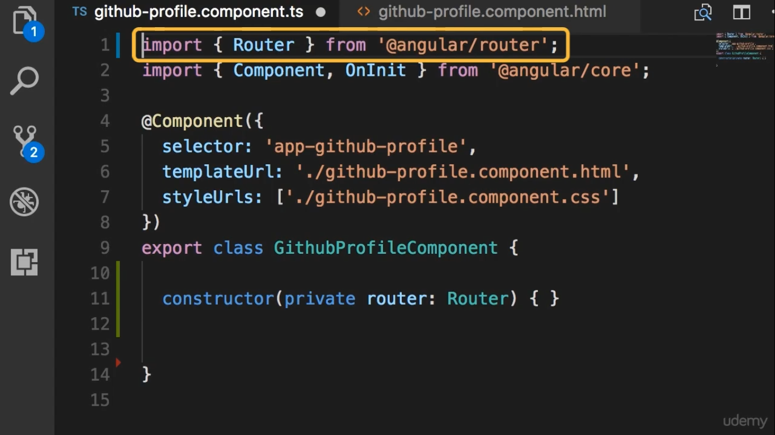

Slide 5
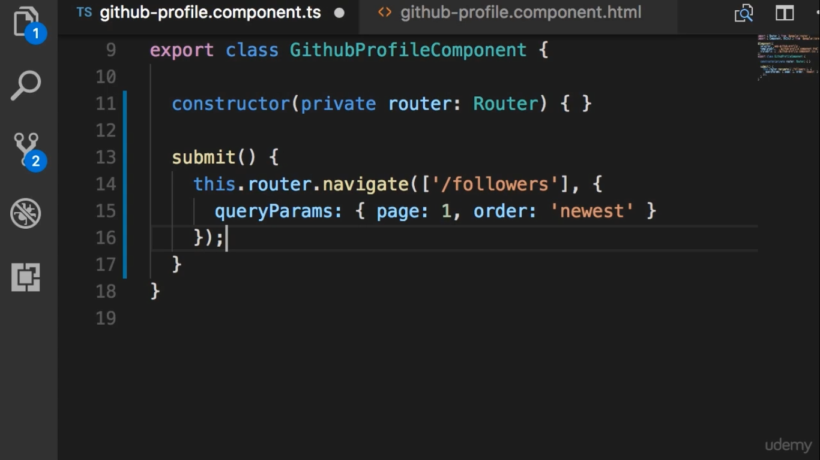
Navigation extra object

